Slide 1
TEST
SEB GROUP

Slide 2
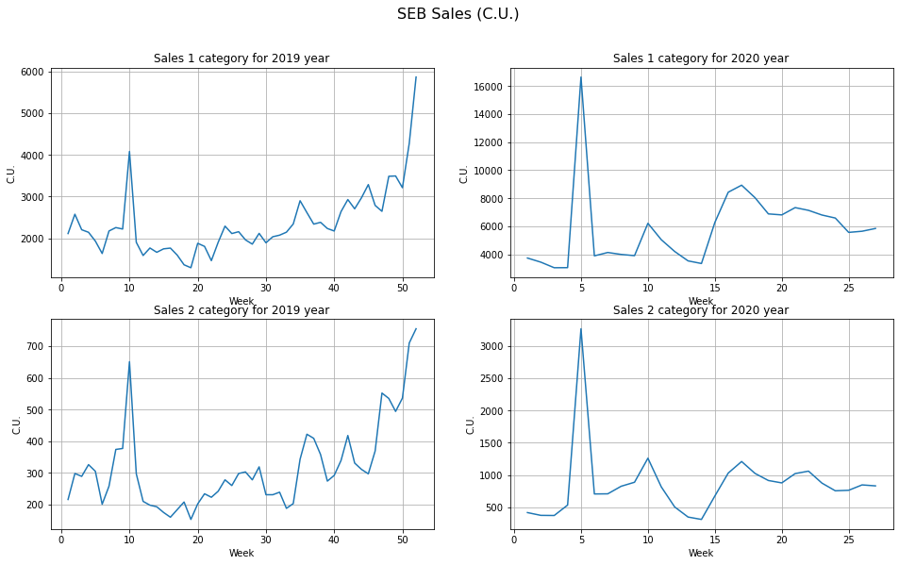
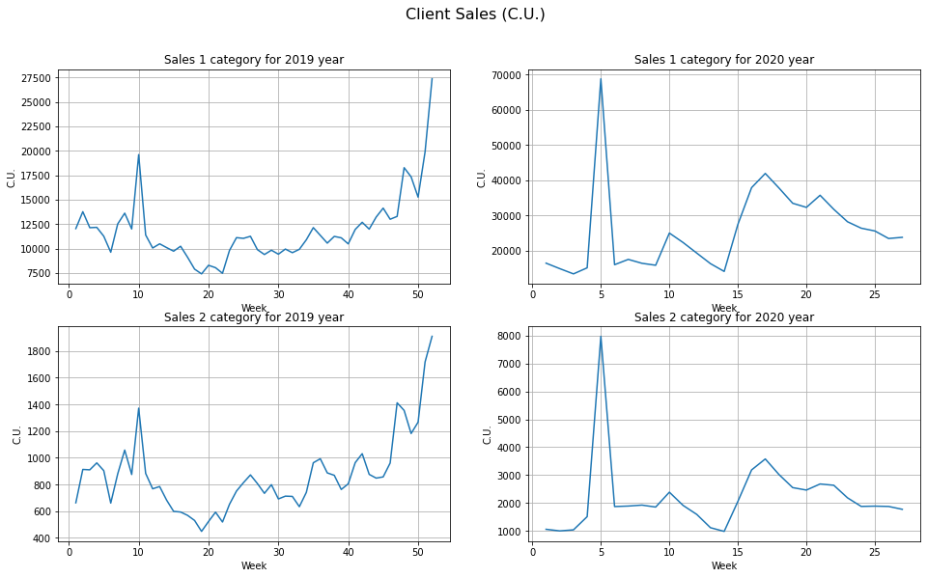
Task 1.1
Since the exact concepts of the columns are not specified, I decided that the SEB Sales (C.U.) column is SEB sales, and Client Sales (C.U.) is sales of other manufacturers to customers.
Let's build distribution schedules for the sale of goods of categories 1 and 2 for 2019 and 2020.
The number of units sold in 2020 is much higher than in 2019, which is in the first and second categories. Let's look at the frequency of prices by years and categories.

Slide 3
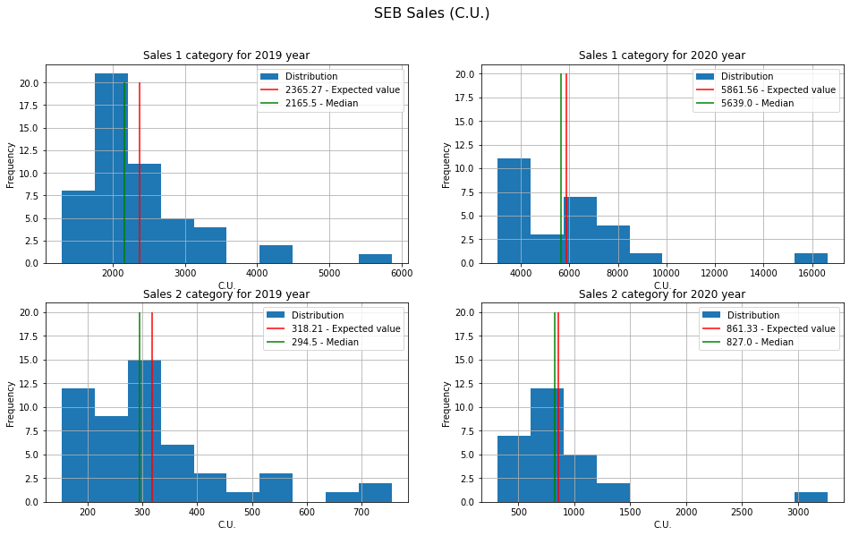
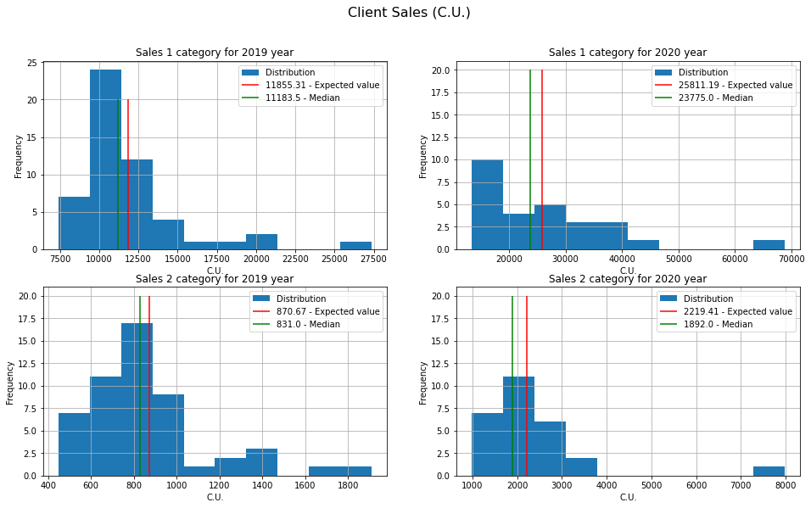
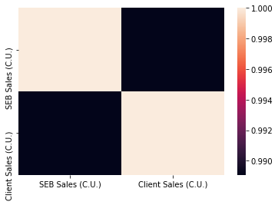
Let's calculate the median and mathematical expectation. This will give us a better understanding of the nature of sales
Judging by the median and mat. expected, the number of units of goods sold at the beginning of 2020, more than in 2019
You can also tell this by subtracting Client Sales and SEB Sales and looking at their checkmate. expectation and median. You can also notice that the 2nd category is sold less than the first category. Let's look at the correlation
You can see a clear correlation between Client Sales and SEB Sales

Slide 4
Having calculated the ratio of medians, we can say about the importance of categories in sales
From the ratio of medians and graphs, it can be seen that category 1 has higher sales in the market than products of category 2
1. Sales for the beginning of 2020 are much higher than for 2019. In the first category at 2.22, in the second category at 2.42 times, judging by the median.
2. Client Sales correlates with SEB Sales.
3. In 2019, the median of the 1st category of goods differs from the median of the 2nd category by 11.8 times. In 2020, 10.84 times.

Slide 5
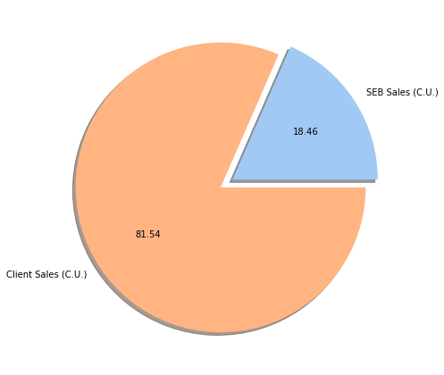
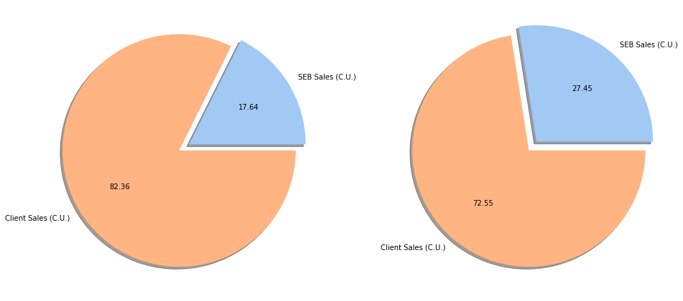

Task 1.2
SEB share and Client share in 1 category
SEB share and Client share in 2 category
SEB share and Client share for goods of all categories for 2019 and 2020
For the calculation I used the following formula. I used this formula since the sales volumes of goods on the market are given
Qн - the volume of sales of the analyzed company in monetary (ruble) or natural (unit) terms;
Qобщ is the total volume of sales in the market.
Market share for SEB in 1 category = 17.63 %
Market share for SEB in 2 category = 27.44 %

Slide 6
Task 1.3
1. I would use an A/B test to confirm the hypothesis. A - sale of old vacuum cleaners. B - sale of vacuum cleaners with new technology. Also for better A/B testing, I would do A/A testing. Then he conducted the same test only on goods of other categories. Metric = number of vacuum cleaners bought per day
2. I would conduct a test in Moscow in an online store, during the period without holidays, for people in the category from 20 to 70 years old with the same promotion in both cases within a month. Product category - vacuum cleaners.
3. At best, I would understand how the novelty of vacuum cleaner technology affects the sales volume of vacuum cleaners. In the worst case, I would understand that I made a mistake with the metric or with the conditions for conducting the A / B test.

